Slide 1
Binary (Bitwise) AND

Slide 2
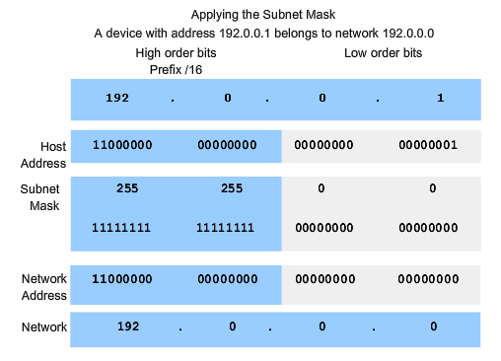
Applying The Subnet Mask – Using a Binary AND
AND Rules:
0+0=0
0+1=0
1+0=0
1+1=1
Notes:
{Complete the ANDing exercise}
{Remove the binary and discuss how you can do this exercise not using binary (ANDing in binary)}

Slide 3
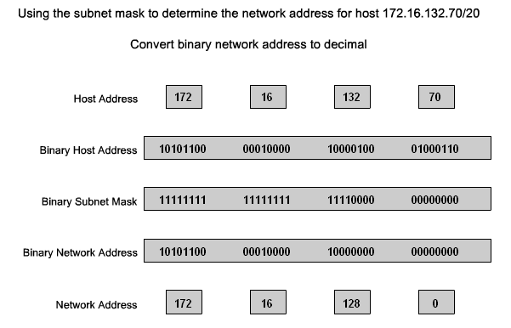
Applying a Subnet Mask that does not border an octet
Subnet Mask
255 255 240 0
Notes:
{Challenge students about how to approach this task without using binary}
{Work through the binary ANDing}

